Slide 1
The IFTA Chronicles – Yet to Come?
Bob Pitcher: ATA; Dawn Lietz: NV DMV;
Charles Ledig: Penske Truck Leasing

Slide 2
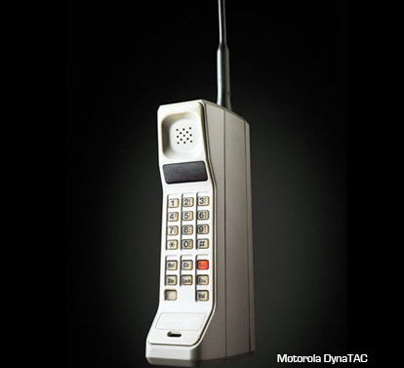
A COMMON LINK
What do
and
and
Have in common?
1983
Notes:
Imagine if
Add US, Canada, Mexico maps

Slide 3
Millennials
First millennials graduated high school in 2000
Age range approximately: 17 – 34
By 2030 will make up about 50% of US workforce
Majority believe technology makes life easier
Civic-minded: Strong sense of community
Very confident: Taught there is nothing they cannot accomplish
Notes:
IRP; IFTA; UCR; HVUT; Weight Distance;

Slide 4
IFTA
Founded 1983:
ISTEA 1991: Mandated membership by Sept 1996
Current Membership: 1996 (includes 48-Contiguous US States and 10 Canadian Provinces)

Slide 5
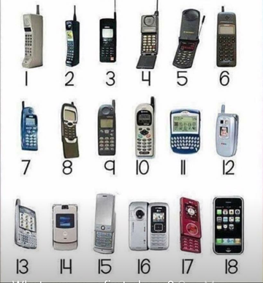
Evolution of the Cell Phone
1983
1989
1993
1983 – (1G) Talking
1992 (2G) SMS (text)
1996 Internet
1999 Media (WAP)
2001 (3G) in Japan
2002 MM and Camera (sold US)
2003 Blackberry (Color screen)
2007 Apple iPhone 2009 (4G/LTE) in US
20xx (5G) early 2020’s
1998
2003
2007
2004

Slide 6
Similarities
“Debuted” in or near 1983
Gained momentum (blossomed) around millennium
All are strongly driven by technology advances

Slide 7
Differences
Millennials: Adapt and embrace technology changes
Willing to pay for latest/greatest technology releases
Motivated and challenged by advances in technology
IFTA: Dependent upon membership to embrace changes
Ballots required to adopt change
Programming costs hinder acceptance of changes
Mobile technology: Partners with communication networks
Fiber Optics/Cell Towers/Satellite Communications
High Tech competition spurs new advancements

Slide 8
Autonomous Vehicles

Slide 9
Stages of Automation
Level 0 – Human driver in complete control
Level 1 – Individual controls are automated-Human control
Level 2 – At least 2 functions automated in unison
Level 3 – Car is in control – Human on standby
Level 4 – Car drives itself in most environments
Level 5 – All robot, all the time – Human along for the ride

Slide 10
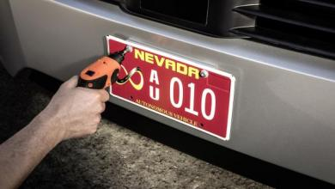
Autonomous Vehicles – How might they affect us? -Changes to HOS? -Need for fewer drivers? -Shift from “fossil fuels” to alternative sources, such as electric/solar? -Greater vehicle efficiency = lower MPG’s? - NEED FOR INFRASTRUCTURE CHANGES?

Slide 11
Age of Autonomy
By now, we all know about vehicles. But there’s more….“Objects you’ve never even considered will become smart devices - dog collars, coffee makers, windows. It will become a practical necessity for devices to operate autonomously.” Craig Macy, CEO of Onstream.
Top 8 companies as of December 2015
VIV; Wit.ai; Cohda Wireless; Saffron Technology; IBM Watson Developer Cloud; Edge3 Technologies; B+B SmartWorx; and Filament.
Source: https://venturebeat.com/2015/12/12/autonomous-tech-will-surge-in-2016-keep-an-eye-on-these-8-players/

Slide 12
Platooning – What is it?
Platooning is a convoy of trucks equipped with state-of-the-art driving support systems
Uses Vehicle to vehicle (V2V) communication technology to simultaneously brake and accelerate

Slide 13
Platooning – What are the benefits?
Increases the capacity of roads by decreasing the distance between vehicles
Increases road safety
Reduces fuel consumption and CO2 emissions
Makes good use of autonomous technology

Slide 14
One Company’s Brief Perspective
The Future of Transportation – The Known and Unknown

Slide 15
What We Know
Connected Fleets
Telematics
Big Data Platform
Efficient / Effective Operation
Route Optimization / Fuel Stop Planning
Predictive Vehicle Maintenance
Improved Safety

Slide 16
What We Don’t Know – But Know is Coming
Electrification / Alternative Fuels
Battery
Fuel Cell
Platooning
Drive Fuel Efficiency
Autonomous Vehicles
Effective / Efficient
Safety

Slide 17
What If?....
Regulatory Environment (EPA, State Gov’t, etc.)
May Dictate Changes Sooner Than Later?
Connected “Things”
Comprehensive Visibility to How Much, When and Where?
Single Revenue Source Model
Leverage Technology to Evolve / Phase-In Revenue Generation Systems to One Platform?
IFTA; IRP; Base Registration; VMT; Tolling; Etc.

Slide 18
THE FUTURE IS HERE NOW; IT’S JUST NOT EVENLY DISTRIBUTED. -- Wm. Gibson

Slide 19
Dividing Up the World
Fuel Equipment
Labor Investment
Freight Roads
Regulation Government

Slide 20
FUEL
Alternative Fuels – or Power Sources
Popular Again Once Diesel Goes Up
Challenges for Tax Administration
Strain on the Fuel Tax?

Slide 21
And a Bit About VMTs
Mostly Just a Concept…
Except for Weight-Distance Taxes
Miserable History for W/D
Can Technology Fix the Troubles?

Slide 22
Why VMT’s Are Not Likely
Fuel Taxpayers Number in the Hundreds
VMT Taxpayers in the Multi-Millions!
Administrative Costs
Evasion & Avoidance
Privacy Concerns

Slide 23
Equipment
Automated Trucks Are Here Now!
(Mostly) Autonomous Trucks Will Be Here Soon
Autonomous Vehicles Could Change Road Use SIGNIFICANTLY
More Stress on Road Funding?

Slide 24
Labor
Shortage of Truck Drivers Continues
Shortage of Technicians Worsening
What Does the Fellow in an AT DO?
Different Jobs / Different Mix of Workers

Slide 25
Investment
Increasing Regulation, Innovation, Labor Shortages
WHERE’S THE MONEY GONNA COME FROM?
Increase in Freight + Capacity Shortage = Higher Rates
Tax Reform?

Slide 26
Freight
Much More of It
Trucks Will Move It
Lighter Loads, Shorter Hauls
More Frequent: 3D Printing; the Amazon Model

Slide 27
Roads
WHERE’S THE MONEY GONNA COME FROM?
Changed Configurations for AV?
How Will AV Change Road Use?

Slide 28
Regulation
Road Taxes? Fuel Tax Good At Least a Decade More
ELDs
Electronic Records
Regulatory Climate Changing?

Slide 29
Government
Politics About to Get REALLY Nasty?
Strains in Federalism
State Pension, Budget Problems
Changes in Government Labor Force

Slide 30
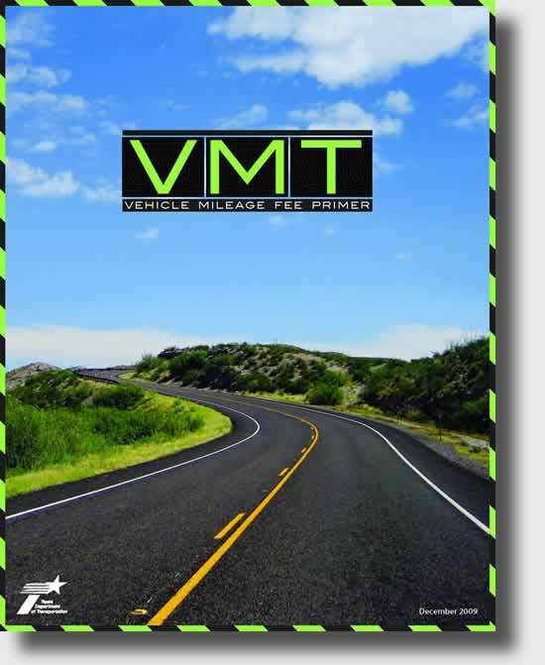
What is VMT
Vehicle miles of travel or vehicle miles traveled (VMT) is defined by the U.S. government as a measurement of miles traveled by vehicles within a specified region for a specified time period.
Information courtesy of Mike Albin - SICPA

Slide 31
Why are States Interested in VMT
The American Society of Civil Engineers says our system of roads, bridges, sewers, dams and ports combined, stated that the stimulus package of $700 billion that was passed in 2009 was not enough and will not help the future of maintaining Transportation methods in the US.
The Highway Trust Fund in the U.S. is essentially in receivership, until 2017 there was little to no willingness to talk about increasing the fuel tax. The last federal fuel tax increase was in 1993.
Last increase was over 24 years ago
In 2012 Average miles per gallon was 23.6, in 2016 went up to 24.8
Appears to be a minimal difference, but just over 1 gallon better gas mileage reduces the highway fund between 5%-10%
Information courtesy of Mike Albin - SICPA

Slide 32
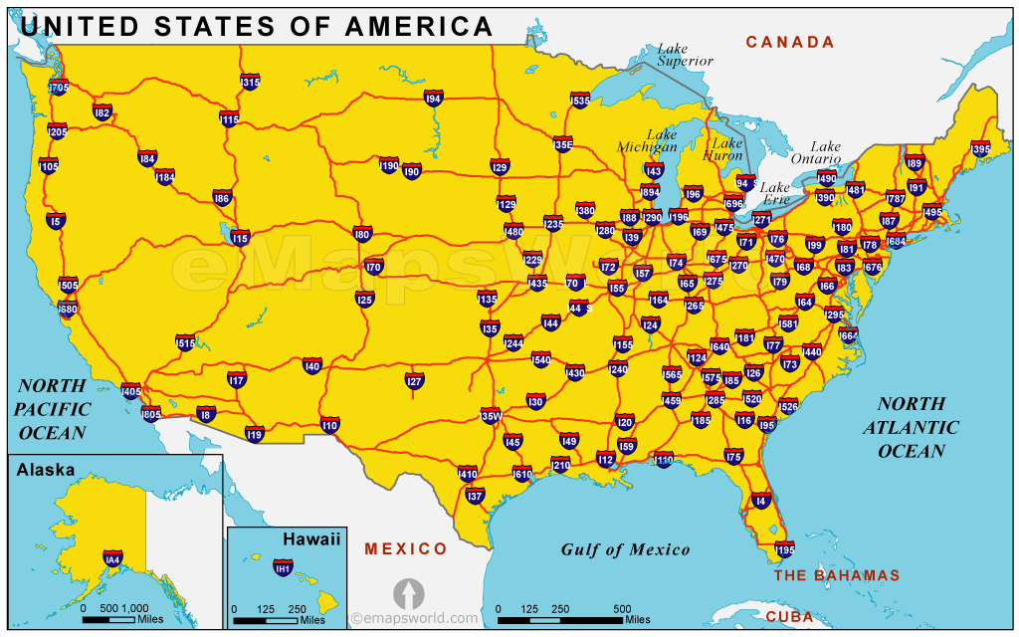
Are States losing
According to the FHWA 3.2 trillion miles were traveled on US roadways in 2016
5th straight year of increased mileage, but this puts more demand on our roadways
In 2016 California alone accounted for 13% of all the miles traveled in the US
Which means on average approximately each state would represent 1.78% each of total miles remaining.
Many states just do not have enough funding to maintain their infrastructure
Information courtesy of Mike Albin - SICPA

Slide 33
VMT’s - Just more questions
Are we are treating VMT as just some big science project and looking the other way when it comes to what is really needed to support a VMT?
Do we need to look more closely at alternatives through Vehicle Registration fees or listen to millennials?
Do we need to look at other program initiatives for increasing transportation funding for infrastructure renewal programs?
Information courtesy of Mike Albin - SICPA

Slide 34
Millennials will change the Future of Transportation
The Millennial Generation
The largest and most diverse generation in American history
40% of Millennials are African American, Latino, Asian or racially-mixed compared to only 25% of the next two older generations.
Millennials are multimodal
They choose the best transportation mode (driving, transit, bike, or walk) based on the trip they are planning to take.
Public transportation options is the mode of Transportation millennials are choosing
Mass Transit allows Millennials to get to work as well as play
Rather not be bothered by driving and finding a parking space
Reasons and motivations for transportation choices
46% Need to save money for the future - Unlike baby boomers who normally started saving in the mid 30’s
46% convenience - Can stay connected with friends
44% want to go places - like the gym, dinner and vacations and a car could prevent this
35% want to live in a community where it just makes sense to use transit.
Information courtesy of Mike Albin - SICPA

Slide 35
Millennials are our future – WE MUST LISTEN
61% want more reliable mass transportation systems
Compared to 35% of baby boomers
55% want real-time updates
Compared to 18% of baby boomers
75% want better/faster Wi-Fi connections
Compared to 65% of baby boomers
44% want a less stressful work place
Compared to 68% of Baby boomers
48% want more vacation time to travel and see the world
Compared to 31% of baby boomers
40% want to own a home
Compared to 92% of baby boomers
38% want eat healthy and exercise
Compared to 22% of baby boomers
30% want to own at least one television
Compared to 91% of baby boomers
30% want to own a car
Compared to 89% of baby boomers
34% feel social media is the way to network
Compared to 16% of baby boomers
Information courtesy of Mike Albin - SICPA

Slide 36
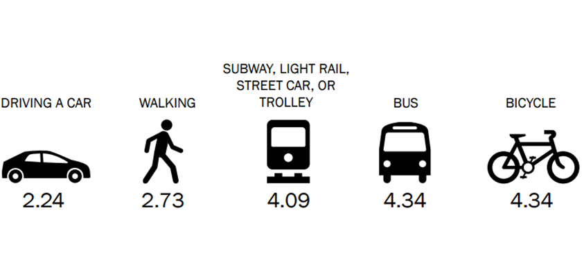
Top 5 modes of transportation for Millennials
Information courtesy of Mike Albin - SICPA

Slide 37
The $1,000,000 Question
How do we sustain the funding for future highway infrastructure needs?
Maintain status quo and rely solely on fuel taxes?
VMT’s?
Virtual Tolling?
Parking meters for electric vehicle charging stations?
What if hybrid technology is combined with solar?
Combination of multiple taxing sources?
???
THE FUTURE IS HERE…THE FUTURE IS NOW…ARE YOU READY?

Slide 38
Final Thought by Deiter Bohn, The Verge
“And the thought that kept occurring to me is how little everybody knew about what was about to happen to the smartphone industry before the iPhone came along. Nobody knew what they didn’t know.”

